Slide 1
DSIP – Lecturer 13 Image Enhancement in the Spatial Domain Neighbourhood Operations

Slide 2
Topics
Basics of Spatial Filtering
Overcoming the Edges Problems
Correlation & Convolution
Spatial Filtering for Image Sharpening
Mathematical Basis of Filtering for Image Sharpening

Slide 3
Neighbourhood Operations
Neighbourhood operations simply operate on a larger neighbourhood of pixels than point operations
Neighbourhoods are mostly a rectangle around a central pixel
Any size rectangle and any shape filter are possible
Origin
x
(x, y)
Neighbourhood
7/31/2020
y
3
Image f (x, y)
Notes:
3

Slide 4
Local Enhancement through Spatial Filtering
The output intensity value at (x,y) depends not only on the input intensity value at (x,y) but also on the specified number of neighboring intensity values around (x,y)
Spatial masks (also called window, filter, kernel, template) are used and convolved over the entire image for local enhancement (spatial filtering)
The size of the mask determines the number of neighboring pixels which influence the output value at (x,y)
The values (coefficients) of the mask determine the nature and properties of enhancing technique
7/31/2020
4

Slide 5
Simple Neighbourhood Operations
Some simple neighbourhood operations include:
Min: Set the pixel value to the minimum in the neighbourhood
Max: Set the pixel value to the maximum in the neighbourhood
Median: The median value of a set of numbers is the midpoint value in that set (e.g. from the set [1, 7, 15, 18, 24] 15 is the median). Sometimes the median works better than the average
7/31/2020
5
Notes:
5

Slide 6
Simple Neighbourhood Operations Example
Original Image
x
Enhanced Image
x
123
127
128
119
115
130
140
145
148
153
167
172
133
154
183
192
194
191
194
199
207
210
198
195
164
170
175
162
173
151
y
y
7/31/2020
6
Notes:
6

Slide 7
The Spatial Filtering Process
Origin
x
a
b
c
r
s
t
d
e
f
*
u
v
w
g
h
i
x
y
z
Original Image Pixels
Filter
Simple 3*3 Neighbourhood
e
3*3 Filter
e_{processed} = v*e + r*a + s*b + t*c + u*d + w*f + x*g + y*h + z*i
y
Image f (x, y)
The above is repeated for every pixel in the original image to generate the smoothed image
7/31/2020
7
Notes:
7

Slide 8
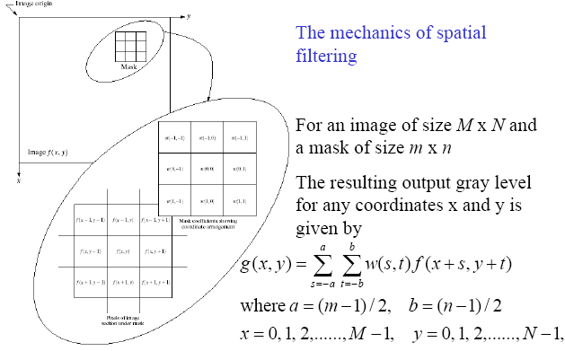
Local Enhancement through Spatial Filtering
7/31/2020
8

Slide 9
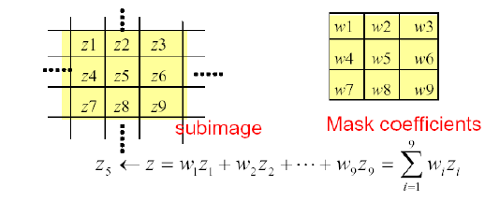
Basics of Spatial Filtering
Given the 3×3 mask with coefficients: w₁, w₂,…, w₉
The mask covers the pixels with gray levels: z₁, z₂,…, z₉
z gives the output intensity value for the processed image (to be stored in a new array) at the location of z₅ in the input image
7/31/2020
9

Slide 10
Basics of Spatial Filtering
Mask operation near the image border
Problem arises when part of the mask is located outside the
image plane; to handle the problem:
1. Discard the problem pixels (e.g. 512x512input 510x510output, if mask size is 3x3)
2. Zero padding: expand the input image by padding zeros (512x512input 514x514output)
– Zero padding is not good; creates artificial lines or edges on the border
3. We normally use the gray levels of border pixels to fill up the expanded region (for 3x3 mask). For larger masks a border region equal to half of the mask size is mirrored on the expanded region.
7/31/2020
10

Slide 11
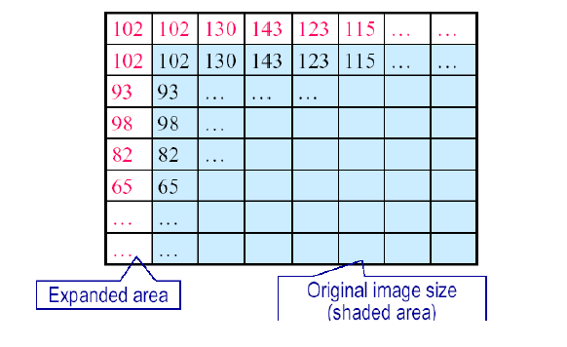
Mask Operation Near the Image Border
7/31/2020
11

Slide 12
Spatial Filtering for Smoothing
For blurring/noise reduction;
Blurring is usually used in preprocessing steps,
e.g., to remove small details from an image prior to object extraction, or to bridge small gaps in lines or curves
Equivalent to Low-pass spatial filtering in frequency domain because smaller (high frequency) details are removed based on
neighborhood averaging (averaging filters)
Implementation: The simplest form of the spatial filter for averaging is a square mask (assume m×m mask) with the same coefficients 1/m2 to preserve the gray levels (averaging).
Applications: Reduce noise; smooth false contours
Side effect: Edge blurring
7/31/2020
12

Slide 13
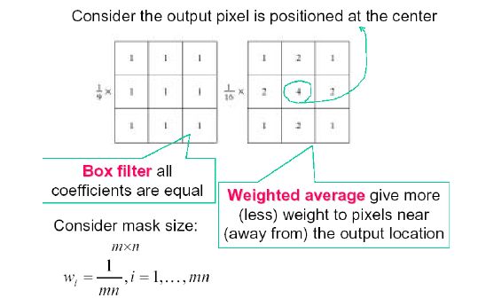
Smoothing Filters
7/31/2020
13

Slide 14
Smoothing Spatial Filters
One of the simplest spatial filtering operations we can perform is a smoothing operation
Simply average all of the pixels in a neighbourhood around a central value
Especially useful in removing noise from images
Also useful for highlighting gross detail
¹/₉ | ¹/₉ | ¹/₉
¹/₉ | ¹/₉ | ¹/₉
¹/₉ | ¹/₉ | ¹/₉
Simple Averaging Filter
7/31/2020
14
Notes:
14

Slide 15
Smoothing Spatial Filtering
Origin
x
104
100
108
¹/₉
¹/₉
¹/₉
99
106
98
*
¹/₉
¹/₉
¹/₉
95
90
85
¹/₉
¹/₉
¹/₉
Original Image Pixels
Filter
¹/₉
¹/₉
¹/₉
Simple 3*3 Neighbourhood
104
100
108
3*3 Smoothing Filter
¹/₉
¹/₉
¹/₉
99
106
98
¹/₉
¹/₉
¹/₉
95
90
85
e = ¹/₉*106 + ¹/₉*104 + ¹/₉*100 + ¹/₉*108 + ¹/₉*99 + ¹/₉*98 + ¹/₉*95 + ¹/₉*90 + ¹/₉*85
= 98.3333
y
Image f (x, y)
The above is repeated for every pixel in the original image to generate the smoothed image
7/31/2020
15
Notes:
15

Slide 16
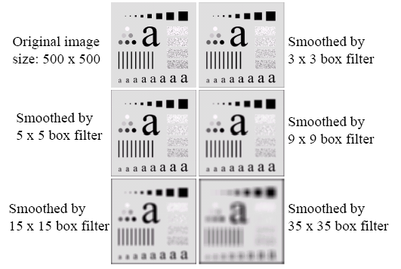
Spatial Filtering for Smoothing (Example)
7/31/2020
16

Slide 17
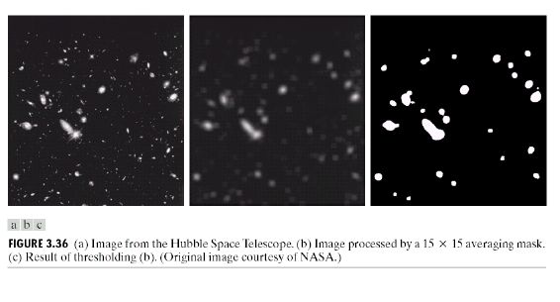
Spatial Filtering for Smoothing (Example)
7/31/2020
17

Slide 18
Weighted Smoothing Filters
More effective smoothing filters can be generated by allowing different pixels in the neighbourhood different weights in the averaging function
Pixels closer to the central pixel are more important
Often referred to as a weighted averaging
¹/₁₆ | ²/₁₆ | ¹/₁₆
²/₁₆ | ⁴/₁₆ | ²/₁₆
¹/₁₆ | ²/₁₆ | ¹/₁₆
Weighted Averaging Filter
7/31/2020
18
Notes:
18

Slide 19
Order-Statistics Filtering
Nonlinear spatial filters
Output is based on order of gray levels in the masked area (sub-image)
Examples: Median filtering, Max & Min filtering
Median filtering
Assigns the mid value of all the gray levels in the mask to the center of mask;
Particularly effective when
– the noise pattern consists of strong, spiky components (impulse noise, salt-and-pepper)
– edges are to be preserved
– Force points with distinct gray levels to be more like their neighbors
7/31/2020
19

Slide 20
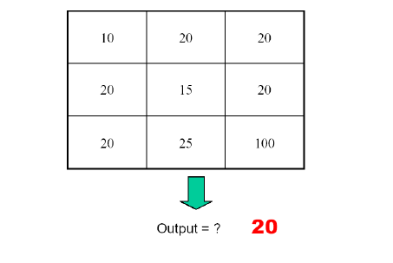
Median Filtering
7/31/2020
20

Slide 21
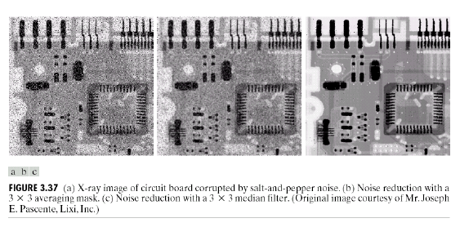
Median Filtering (Example)
7/31/2020
21

Slide 22
Overcoming the Edges Problems
At the edges of an image we are missing pixels to form a neighbourhood
Origin
x
e
e
e
e
e
e
e
7/31/2020
22
y
Image f (x, y)
Notes:
22

Slide 23
Overcoming the Edges Problems
There are a few approaches to dealing with missing edge pixels:
Pad the image
Typically with either all white or all black pixels
Replicate border pixels
Truncate the image
7/31/2020
23
Notes:
23

Slide 24
Simple Neighbourhood Operations Example
x
123
127
128
119
115
130
140
145
148
153
167
172
133
154
183
192
194
191
194
199
207
210
198
195
164
170
175
162
173
151
y
7/31/2020
24
Notes:
24

Slide 25
Correlation & Convolution
The filtering we have been talking about so far is referred to as correlation with the filter itself referred to as the correlation kernel
Convolution is a similar operation, with just one subtle difference
For symmetric filters it makes no difference
a
b
c
r
s
t
u
v
w
e_{processed} = v*e + z*a + y*b + x*c + w*d + u*e + t*f + s*g + r*h
d
e
e
*
x
y
z
f
g
h
Filter
Original Image Pixels
7/31/2020
25
Notes:
25

Slide 26
Spatial Filtering for Image Sharpening
Background: to highlight fine detail in an image or to enhance blurred detail
Applications: electronic printing, medical imaging, industrial inspection, autonomous target detection (smart weapons)......
Foundation (Blurring vs Sharpening):
Blurring/smoothing is performed by spatial averaging (equivalent to integration)
Sharpening is performed by noting only the gray level changes in the image that is the differentiation
7/31/2020
26

Slide 27
Spatial Filtering for Image Sharpening
Operation of Image Differentiation
Enhance edges and discontinuities (magnitude of output gray level >>0)
De-emphasize areas with slowly varying gray-level values (output gray level: 0)
Mathematical Basis of Filtering for Image Sharpening
First-order and second-order derivatives
Gradients
Implementation by mask filtering
7/31/2020
27

Slide 28
Derivatives
First Order Derivative
A basic definition of the first-order derivative of a one-dimensional function f(x) is the difference
Second Order Derivative
Similarly,the second-order derivative of a one-dimensional function f(x) is the difference
7/31/2020
28

Slide 29
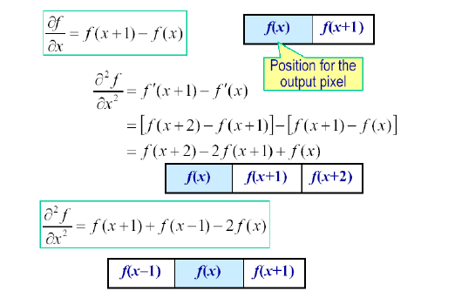
First and Second Order Derivatives
7/31/2020
29

Slide 30
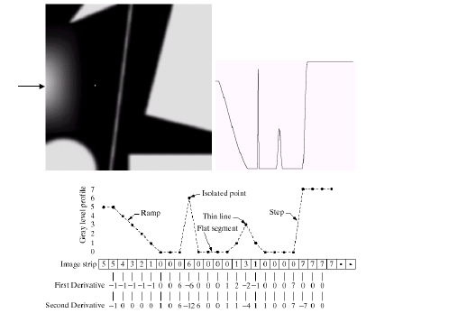
Example for Discrete Derivatives
7/31/2020
30

Slide 31
Comparison between f" and f´
f´ generally produces thicker edges in an image
f" has a stronger response to fine detail
f´ generally has a stronger response to a gray-level step
f" produces a double response at step changes in gray level
For image enhancement, f" is generally better suited
than f´
Major application of f´ is for edge extraction; f´ used together with f" results in impressive enhancement effect
7/31/2020
31

Slide 32
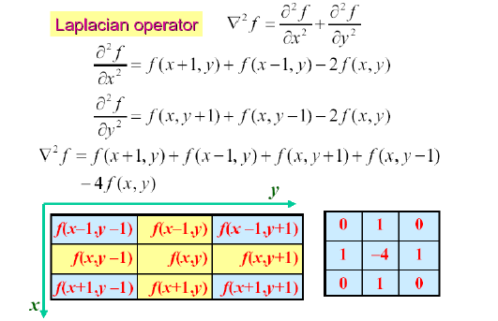
Laplacian for Image Enhancement
7/31/2020
32

Slide 33
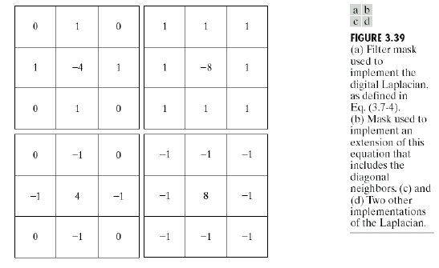
Laplacian for Image Enhancement
7/31/2020
33

Slide 34
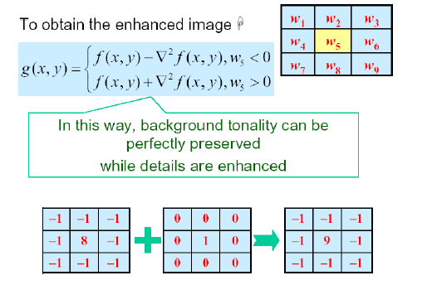
Laplacian for Image Enhancement
7/31/2020
34

Slide 35
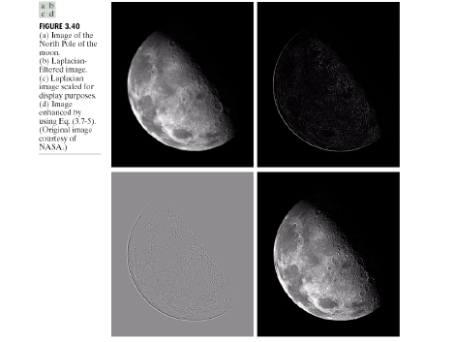
Laplacian for Image Enhancement (Example)
7/31/2020
35

Slide 36
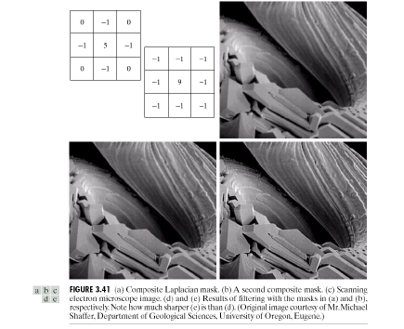
Laplacian for Image Enhancement (Example)
7/31/2020
36

Slide 37
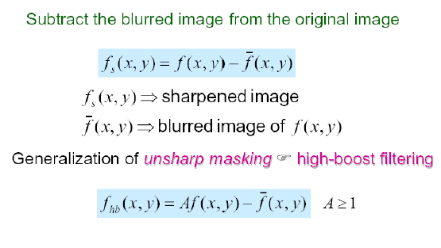
Image Sharpening Based on Unsharp Masking
7/31/2020
37

Slide 38
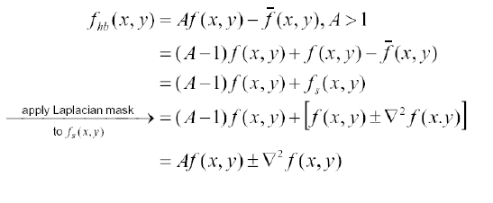
High Boost Filtering
Principal application:
Boost filtering is used when input image is darker than desired,
high-boost filter makes the image lighter and more natural
7/31/2020
38

Slide 39
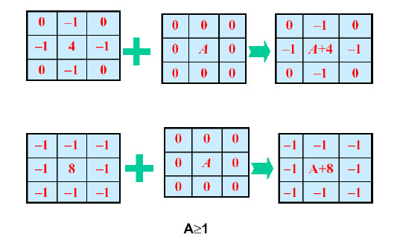
High Boost Filtering Masks
7/31/2020
39

Slide 40
1st Derivative Filtering
Implementing 1st derivative filters is difficult in practice
For a function f (x, y) the gradient of f at coordinates (x, y) is given as the column vector:
Notes:
40

Slide 41
1st Derivative Filtering (cont…)
The magnitude of this vector is given by:
For practical reasons this can be simplified as:
Notes:
41

Slide 42
1st Derivative Filtering (cont…)
Now we want to define digital approximations and their Filter Masks
For simplicity we use a 3x3 region
For example z₅ denotes f(x,y), z₁ denotes f(x-1,y-1)
A simple approximation for First Derivative is
z₁
z₂
z₃
z₄
z₅
z₆
z₇
z₈
z₉

Slide 43

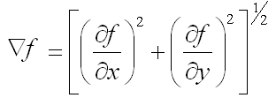

1st Derivative Filtering (cont…)
A simple approximation for First Derivative is
Two other definitions proposed by Roberts use cross- difference
z₁
z₂
z₃
If we use
z₄
z₅
z₆
z₇
z₈
z₉

Slide 44


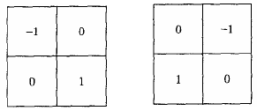
1st Derivative Filtering (cont…)
If we use absolute values then
z₁
z₂
z₃
z₄
z₅
z₆
z₇
z₈
z₉
The Masks corresponding to these equations are:
Roberts Cross-Gradient Operators

Slide 45
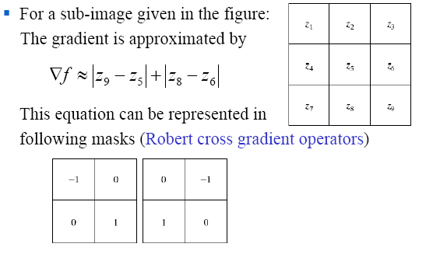
Gradient Operators
7/31/2020
45

Slide 46
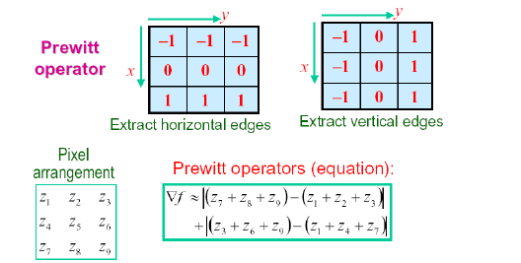
Gradient Operators
Normally the smallest mask used is of size 3 x 3
Based on the concept of approximating the gradient several spatial masks have been proposed:
7/31/2020
46

Slide 47
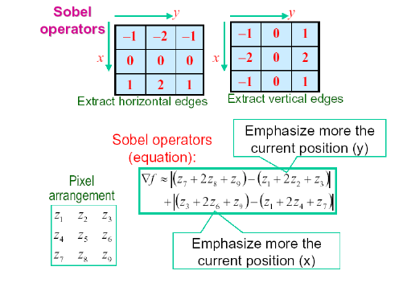
Gradient Operators
7/31/2020
47

Slide 48
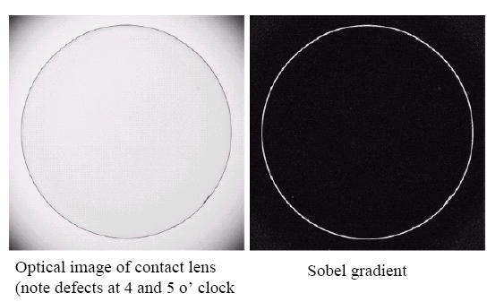
Gradient Processing (Example)
7/31/2020
48

Slide 49
NOTE
The summation of coefficients in all masks equals 0, indicating that they would give a response of 0 in an area of constant gray level.
7/31/2020
49

Slide 50
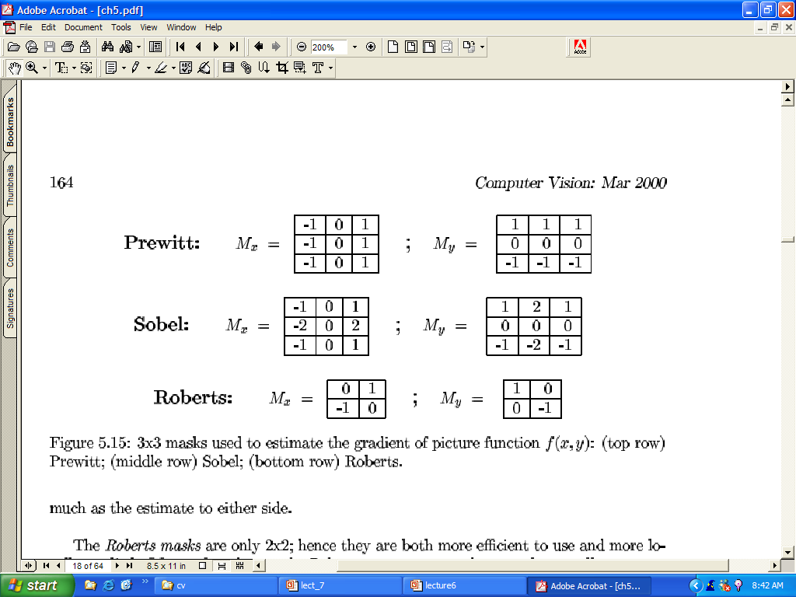
Mask used to estimate the Gradient

Slide 51
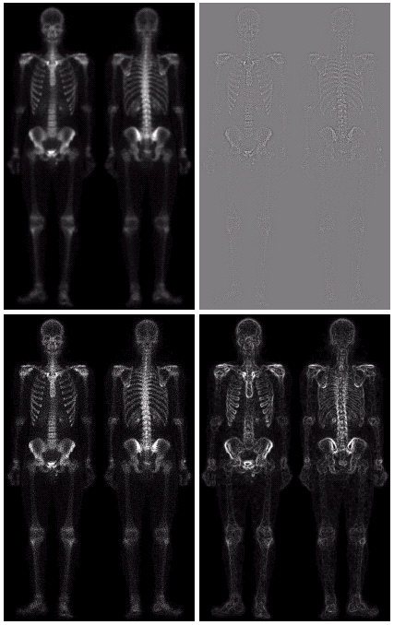
Combining Spatial Enhancement Methods (cont…)
(a)
Laplacian filter of bone scan (a)
(b)
Sharpened version of bone scan achieved by subtracting (a) and (b)
(c)
Sobel filter of bone scan (a)
(d)
Notes:
51

Slide 52
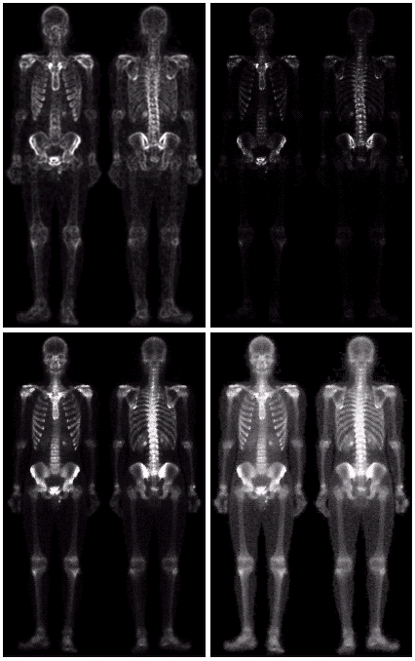
Combining Spatial Enhancement Methods (cont…)
Result of applying a power-law trans. to (g)
(h)
Sharpened image which is sum of (a) and (f)
(g)
The product of (c) and (e) which will be used as a mask
(f)
(e)
Image (d) smoothed with a 5*5 averaging filter
Notes:
52

Slide 53
Combining Spatial Enhancement Methods (cont…)
Compare the Original and Final Images
Notes:
53

Slide 54


